Slide 1
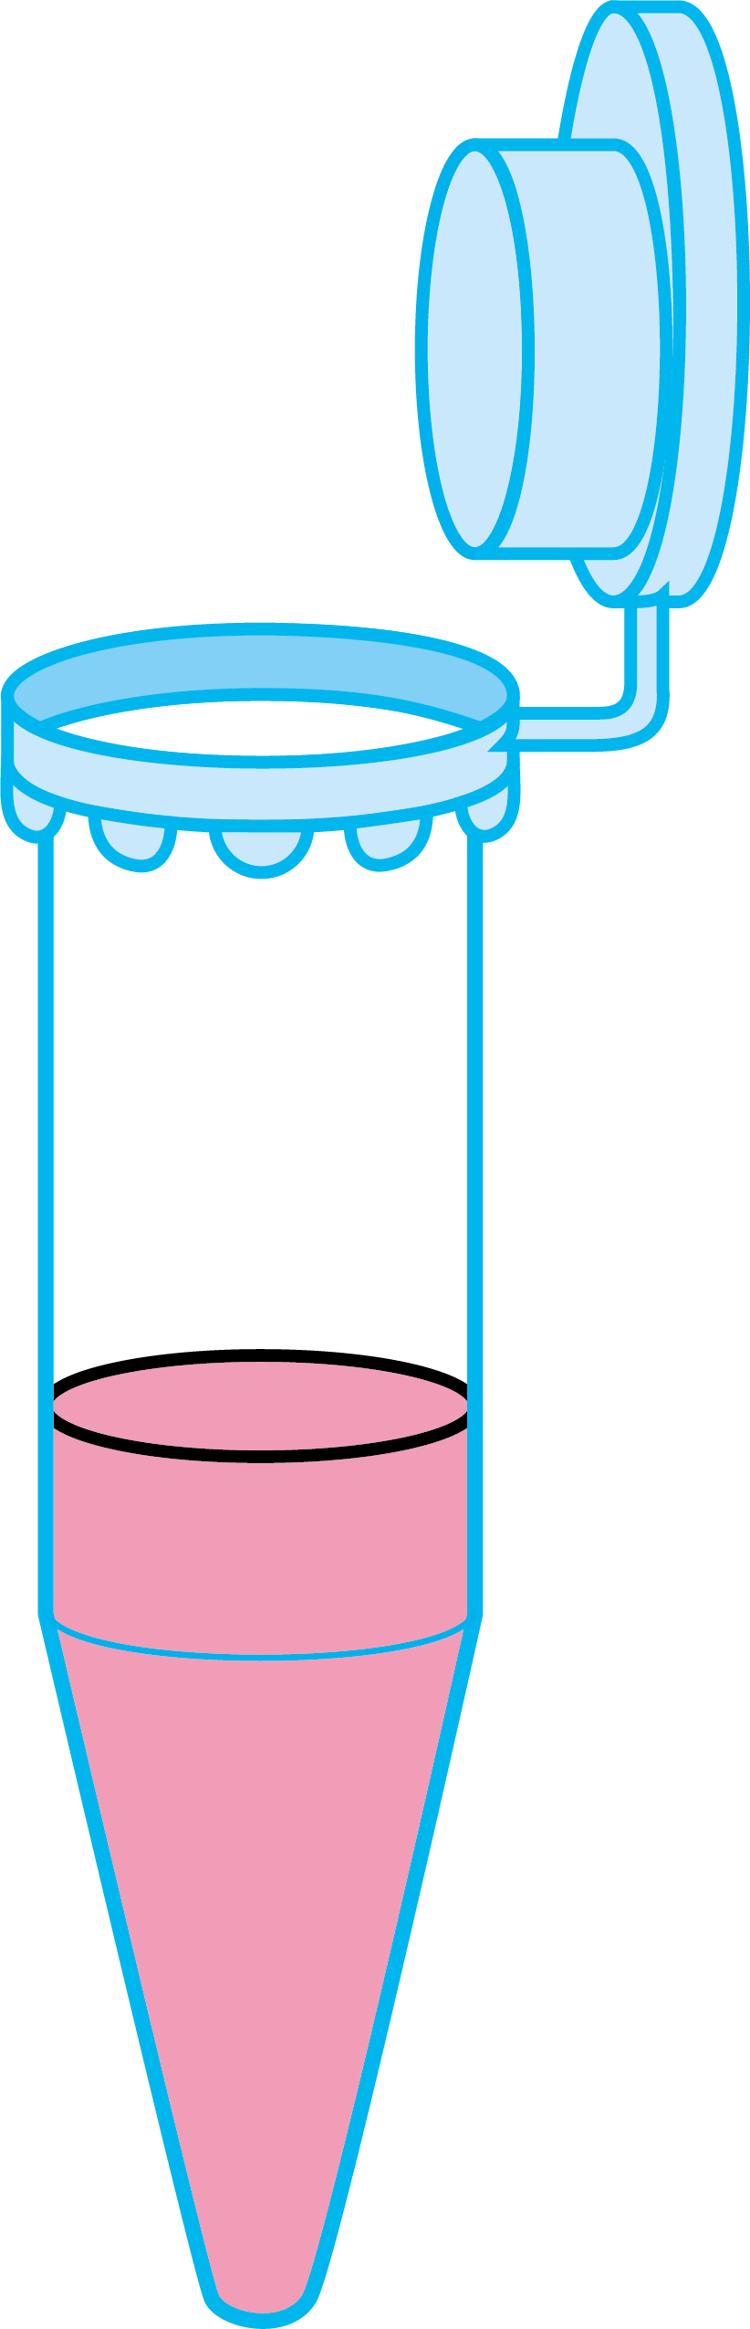
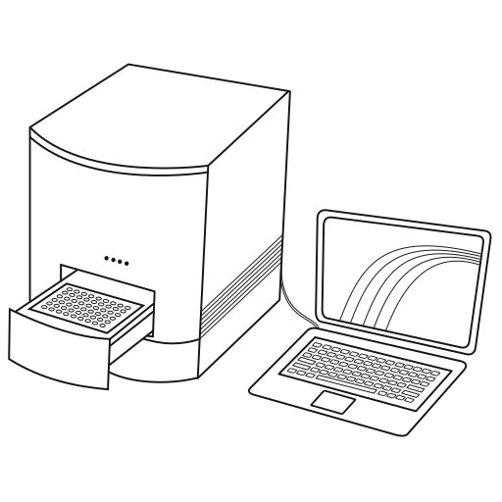
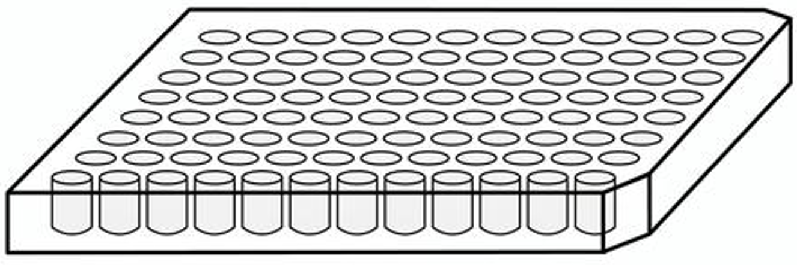

mix sample with AOC
capture immunocomplexes
on plate
qPCR
transfer to
NfL
wash
qPCR plate
add PCR mix
incubate 2hrs
incubate overnight
ligate & cycle
splint
rev
5’ C12 amine
3’ C6 amine
fwd
T4 Ligase
PCR clipart from: https://www.labicons.net/equipments/thermocyclers/doc/real-time-pcr-open.html 96 well plate clipart from: https://en.ac-illust.com/clip-art/2219396

Slide 2
mix sample with AOC
capture immunocomplexes
on plate
qPCR
transfer to
NfL
wash
qPCR plate
add PCR mix
incubate 2hrs
incubate overnight
ligate & cycle
splint
rev
5’ C12 amine
3’ C6 amine
fwd
T4 Ligase

Slide 3
NfL
T4 Ligase
NfL
splint
rev
5’ C12 amine
3’ C6 amine
fwd
NfL
T4 Ligase
NfL
splint
rev
5’ C12 amine
3’ C6 amine
fwd

Slide 4
